Slide 1

MCOSS2WED
JavaScript: Displaying text files

Slide 2

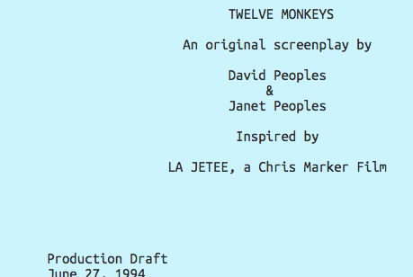
Displaying a text file using JS
We are going to be looking at using JavaScript to display simple text files on a web page.

Slide 3
Uses
Being able to read and present text files in a web page using JavaScript is useful in many different scenarios:
Displaying fixed textual content
Displaying dynamic content (perhaps even HTML)
Third-party updates (eg: sales team)
Product descriptions
Item lists

Slide 4
Preparation
Create a new HTML file
Create a new CSS file
Create a new JavaScript file
Download 3 or 4 text files:
http://www.scifiscripts.com
www
some.txt
index.html
css
js
style.css
script.js

Slide 5
Create a file input
Start by creating a file input element within your <body>…</body> tags.
The id can be set to anything you like but be aware that it will be referred to later in JavaScript.
When the type is set to file, it creates a button that allows the user to browse and select a file. Try it out:
<body>
<input type="file” id="chooseFile" />
</body>

Slide 6
Create a file input
At the moment, when a file is chosen, nothing happens.
A JavaScript routine can read the file we choose and display it for us.
But before we create some JS to do this, we need to create a place for it to display the file contents and a link to our script that we will write.
Add these two lines below the input element:
<body>
<input type="file” id="chooseFile" />
<p id="showFile"></p>
<script type="text/javascript" src="js/reader.js"></script>
</body>

Slide 7
Create JavaScript
Now we are ready to add our script to read and display a file.
Copy the file reader.js into your js folder or type/copy this text into a file called reader.js in your js folder:
document.getElementById("chooseFile").addEventListener("change", function() {
var read = new FileReader();
read.onload = function() {
document.getElementById("showFile").textContent = this.result;
}
read.readAsText(this.files[0]);
})

Slide 8
Script explanation
This section looks for an element with an ID that matches ‘chooseFile’.
This function asks the browser to listen to when the ‘chooseFile’ button is clicked.
document.getElementById("chooseFile").addEventListener("change", function() {
var read = new FileReader();
read.onload = function() {
document.getElementById("showFile").textContent = this.result;
}
read.readAsText(this.files[0]);
})

Slide 9
Script explanation
When the ‘chooseFile’ button is used, this function is executed.
We tell the browser where to get ready to display the text file (inside the element with the ID of ‘showFile’)…
…and then read the contents of the file.
document.getElementById("chooseFile").addEventListener("change", function() {
var read = new FileReader();
read.onload = function() {
document.getElementById("showFile").textContent = this.result;
}
read.readAsText(this.files[0]);
})

Slide 10
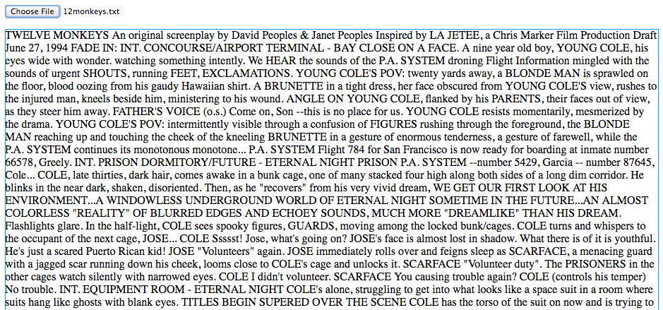
Create JavaScript
All going well, when you choose a file now, the contents should be displayed:

Slide 11
Preformatted text tag
Unless told otherwise, the browser will ignore whitespace formatting.
To correct this, we can use the <pre> tag.
In your HTML, change the <p> tag to <pre> like this:
<pre id="showFile"></pre>

Slide 12
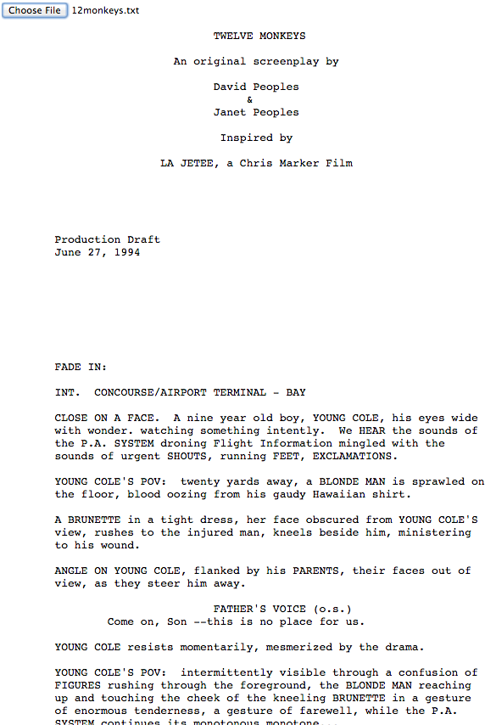
Preformatted text tag
Now, when you choose a file, it should remain formatted (see fr-example1.html).

Slide 13

Text area tag
The contents of the text file covers the entire page which may not be desirable.
To limit the area the text covers, we can use the textarea element.

Slide 14
Text area tag
To use the textarea tag, simply replace the
<pre>…</pre> tags with <textarea>…</textarea> (you might want to add a <br> before it as well):
(see fr-example2.html)
<body>
<input type="file" id="chooseFile" />
<br>
<textarea id="showFile"></textarea>
<script type="text/javascript" src="js/reader.js"></script>
</body>

Slide 15

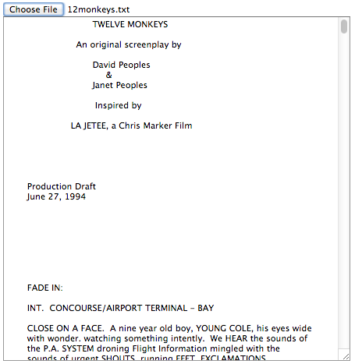
Text area tag
It should look something like this (the text area is resizable):

Slide 16
Styling the input element

Slide 17
Styling
By default, the file input element is not very pretty and is difficult to style.
But we can work around this and make it look like it is styled with a bit of extra HTML and some CSS.

Slide 18
Styling
Alter your existing body section to look like this:
<body>
<div class="menu">
<input type="file" name="file" id="file" />
<label for="file" id="file-upload">Choose a file</label>
</div>
</body>

Slide 19
Styling
We have added a label under the input element…
<body>
<div class="menu">
<input type="file" name="file" id="file" />
<label for="file" id="file-upload">Choose a file</label>
</div>
</body>

Slide 20
Styling
…and created an association between them.
<body>
<div class="menu">
<input type="file" name="file" id="file" />
<label for="file" id="file-upload">Choose a file</label>
</div>
</body>

Slide 21
Styling
The page should render like this:
Input element
Label element

Slide 22
Styling
Add another <div> section below the one you’ve just created.
Like before, this is the element where our text will appear.
<div class="main-container">
<pre id="showFile"></pre>
<script type="text/javascript" src="js/your_file.js"></script>
</div>

Slide 23
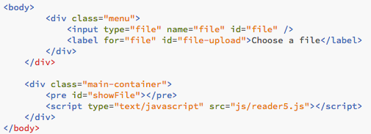
Styling
This is what you should have so far:

Slide 24
Styling
Now we need to hide the original input element.
Is your CSS file, add:
input[type="file"] {
display: none;
}

Slide 25
Styling
The input element should now be hidden on the rendered page leaving just the label.
Try clicking on it. It should still work as the input button did and a file you choose should still load.

Slide 26
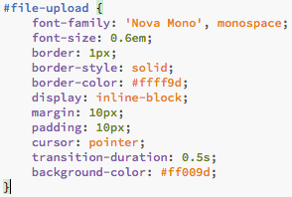

Styling
Style the label to look like a button in CSS using its ID #file-upload (see fr-example5a.html):

Slide 27
Styling
The text that appears in the pre element can also be styled in CSS.
Try changing the pre style.
pre {
font-family: monospace;
font-size: 1.2em;
color: #2e2e2e;
}

Slide 28
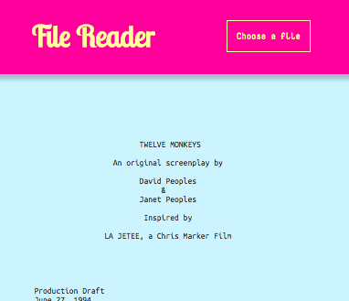
Challenge 1
Can you create a styled menu bar with the file input/label combination of elements in it (see fr-example5.html)?

Slide 29
Challenge 2
Can you make your page responsive – perhaps by altering the font sizes when the viewport width changes (see fr-example5.css)?
(If you set the body font size and use ems elsewhere this will be easier.)

Slide 30
Static file
Displaying a static file located on the web server using JavaScript/JQuery

Slide 31
Static file
So far we have prompted the user to browse for a text file to display.
We can instead display a text file located on our website when the page loads.

Slide 32
Static file
To achieve this, we are going to use an online JQuery library.
Add this line to your HTML page between <head>…</head>:
<script src="https://ajax.googleapis.com/ajax/libs/jquery/3.1.1/jquery.min.js"></script>

Slide 33
Static file
Create a files folder
Copy a text file into this folder
Note the path and file name

Slide 34
Static file
Change your body section to look like this:
<body onload="read();">
<pre id="showFile"></pre>
</body>

Slide 35
Static file
Create a new JavaScript file in your js folder.
Add this to your JavaScript file replacing “your_file_name.txt” with the path and name of your text file:
function read() {
jQuery.get(”your_file_name.txt", function(txt) {
$("#showFile").text(txt);
});
}

Slide 36
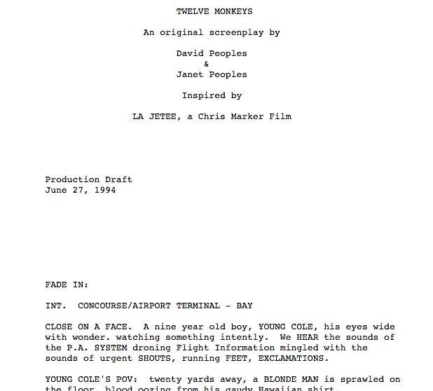
Static file
When you reload the web page, your text file should automatically be displayed (see fr-example4.html).

Slide 37
Summary
We have looked at displaying a text file using two different methods:
Using the input file element to allow the user to choose a file and JavaScript to display it.
Using a JQuery routine to auto-display a pre-determined file.
We have also looked at styling the input file element which involves hiding the input element and displaying a styled label element in its place.

